Slide 1
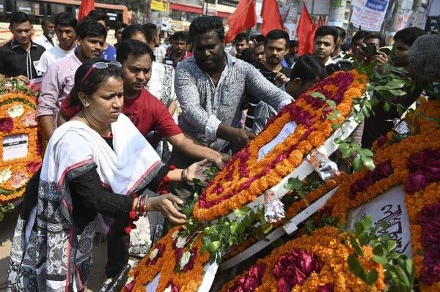
General OHS Factors
Introduction to OHS: Module 3
Supervisors & Managers Introduction to Occupational Health & Safety (OHS) Online Course
Notes:
Trainer:
Introduce third module with a quick re-cap of topic area covered on the last session.
This is an important sessions as it:
Identifies the important role Supervisors & Managers have in promoting OHS policies and practice. They should be role models of good practice; be proactive and supportive and always vigilant for potential risks and hazards.
Deals with the outcomes of poor OHS practice. (E.g. what happens when we get it wrong? (Worker injuries and accidents at the workplace).
Looks at how Supervisors & Managers can be ‘proactive’ and help prevent injuries and work-related ill-health issues by understanding about accident investigation and reporting.

Slide 2
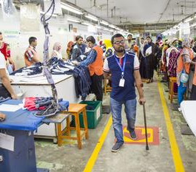
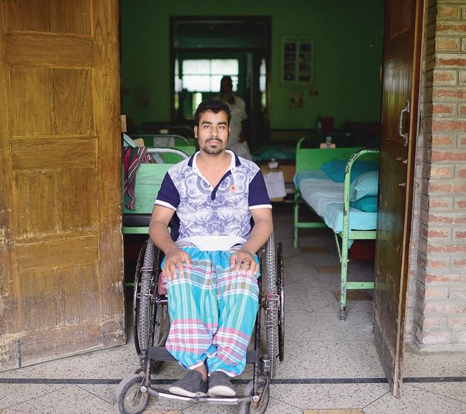
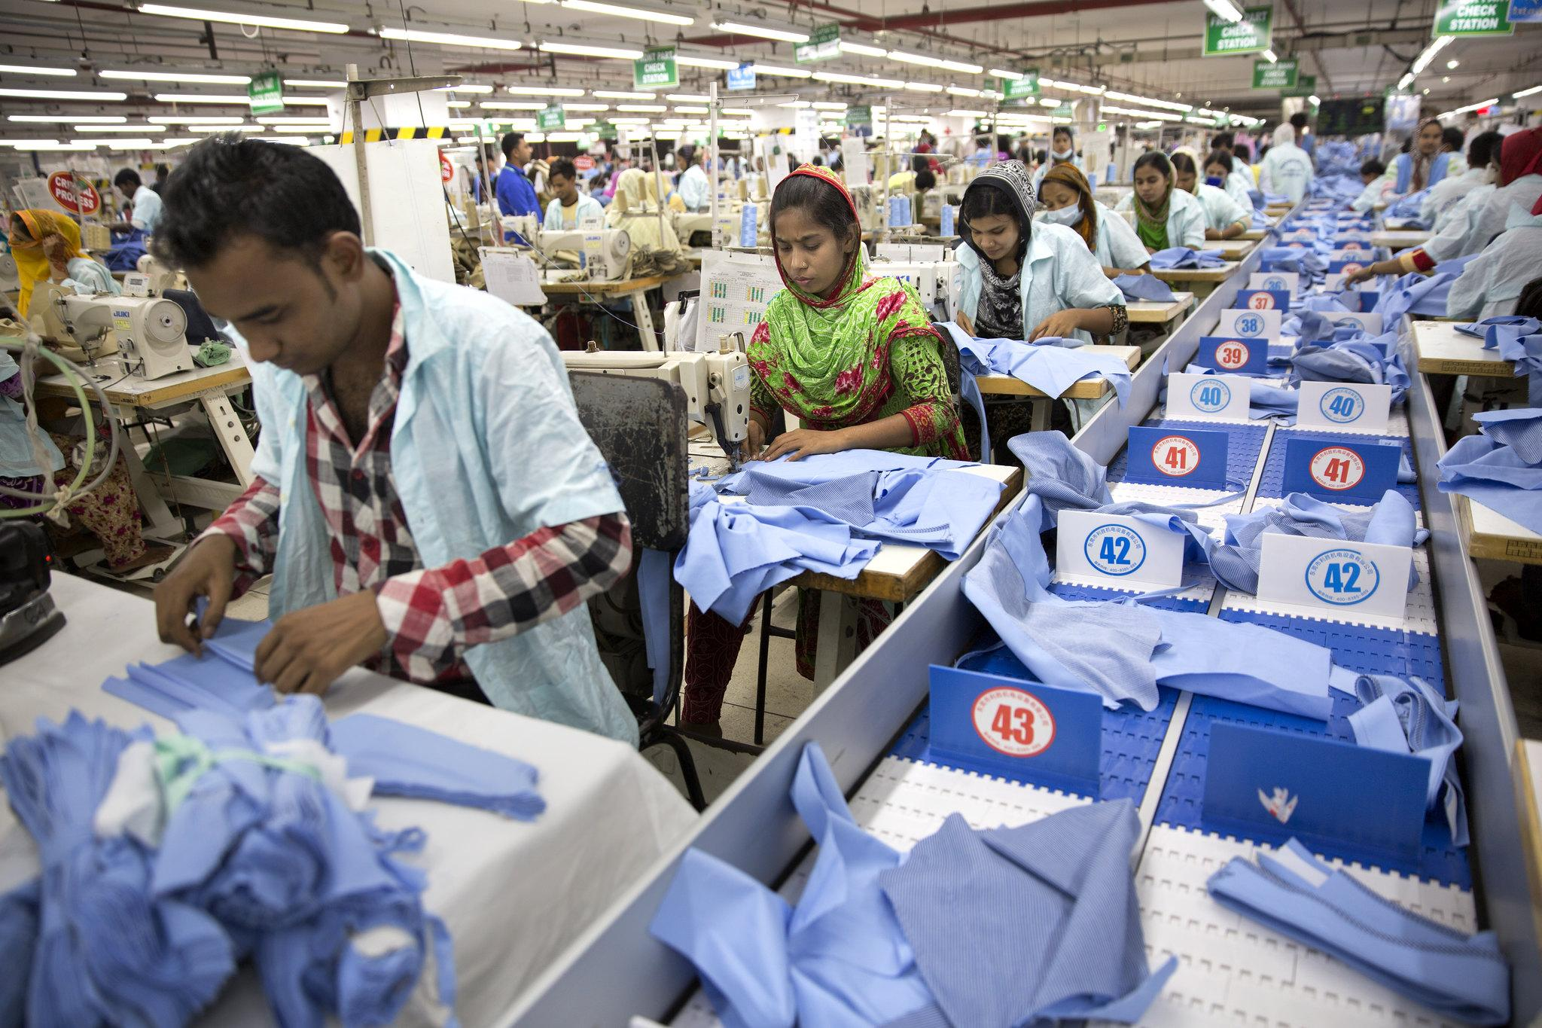
Module 3 - Overview
Policies, Procedures & Practice
Roles & Responsibilities
Accidents: Prevention, Causation, Investigation & Reporting
Notes:
Trainer: Highlight key topic areas being covered in this session.
This module is important as it combines some of the key concepts of OHS policy and management.
Our focus is to adopt a ‘preventative’ approach rather than a compensatory one.
We want to prevent accidents and ill-health rather than compensate workers (and their families) for diseases, injuries or even death.
No amount of money can replace a hand or the loss of one’s eyesight.
So,it is all our interests to carry out our responsibilities to the best of our ability.

Slide 3
These statistics are people just like you…
Remember the global figures from the previous module?
According to the ILO:
Estimated over 11,000 workers suffer fatal accidents
The (20.11.20) identifies 945 workplace deaths in Bangladesh 2019
A further 24,500 die from work-related diseases across all sectors each year in Bangladesh.
Last 10 years, at least 12,864 workers were killed and 11,767 were injured in workplace accidents, according to the report. Garment sector recorded most dead workers - 1,971 of any industrial sector.
Also an estimated a 8 million workers world-wide suffer injuries at work – many of which result in permanent disability.
Internationally recognised that most occupational deaths & injuries are entirely preventable/avoidable if employers and workers took simple initiatives to reduce hazards and risks at the workplace.
Notes:
Trainer: Remind trainees of figures: Every day, people die as a result of occupational accidents or work-related diseases – more than 2.78 million deaths per year.
Every 15 seconds, a worker dies from a work-related accident or disease
Every 15 seconds, 160 workers have a work-related accident There 374 million non-fatal work-related injuries each year, resulting in more than 4 days of absences from work.
The figures on this slide bring things a little closer to home…

Slide 4
Background & context: The RMG Sector in Bangladesh
Catalogue of notorious accidents in the sector:
Rana Plaza, Spectrum Factory, Tazreen Fashions Ltd…Garib & Garib Sweater Factory, That’s It Sportswear, KTS Textile Factory, Shifa Apparels and Omega Sweaters, Eurotex etc…
It has been found that the causes of these incidents are almost 94% by fire, 3.03% by building collapse and another 3.03% by other different incidents.
“The most noticeable matter is that though there are almost 20 major risks in this sector, only 4 or 5 risks are covered by insurance policy”.
The safety record of the Bangladesh garment industry is one of the worst in the world!
Notes:
Trainer: (Just for information do not read these out unless challenged on the origin of the figures.
Sources:
1. ‘Risks Management of Ready-Made Garments Industry in Bangladesh’. Md. M. Hasan, A. Mahmud, Begum Rokeya University. International Research Journal of Busines Studies. Vol 10 No1 2017. https://doi.org/10.21632/irjbs
2. ‘Health Hazards of Garments Sector in Bangladesh: The Case Studies of Rana Plaza’.
Fatema. T, N. Sultana, University of Bangladesh Malaysian Journal of Medical and Biological Research. 2014.
3. ‘Ahmed T, Mia R, Tanjim MN, et al. An extensive analysis of the health hazards for RMG workers in apparel sector of Bangladesh. J Textile Eng Fashion Technol. 2020;6(4An extensive analysis of the health hazards for RMG workers in apparel sector of Bangladesh’ Article in Journal of Textile Engineering. T Ahmed, Md. N Tanjim et al, July 2020.
Although laws are presenting an effort to protect workers, the application of these laws is rare according to various newspaper conducted research (Hossain, 2006).
Many workers do not have the least erudition about occupational health and safety standards.

Slide 5
Accident Reporting & Investigation
Perspectives on OHS (1)
Common Uninformed comments:
accidents just happen…
we don’t have many accidents…
safety is expensive…
the insurance company will pay…
safety is just common sense…
Notes:
Trainer:
Online/Group Activity: Go through each of the statements and generate an online/class discussion.
You may wish to ask the group some of the questions below or highlight some of the comments below:
Does anyone agree with any, or all, of the statements? (if so, why?)
As we shall see, ‘accidents’ don’t just happen they are the result of a series of factors including numerous incidents or ‘near misses’ before the final accident.
Do they know how may accidents occurred in the factory in the last 3 months (Covid-19 will have reduced the number of accidents this year) so ask some of the Managers if they know what the accident rate was for 2019?
They should see safety as an investment not an expenditure. Many OHS preventative measures can be relatively cheap but the cost of negligence or failing to protect workers can be catastrophically expensive for the individual, their families and the company.
Insurance premiums can be very high and expensive. Many companies avoid paying costly premiums and may only be covered for certain eventualities. In most cases, uninsured costs can be up to 10 x the cost of insured costs – see Iceberg slide. Most workers may not be able to afford insurance cover.
How much is your life worth to you and your family?
‘Common sense’ is often not as common as you think! People take risks, employers cut corners and equipment can fail because it is not used properly or poorly maintained etc.

Slide 6
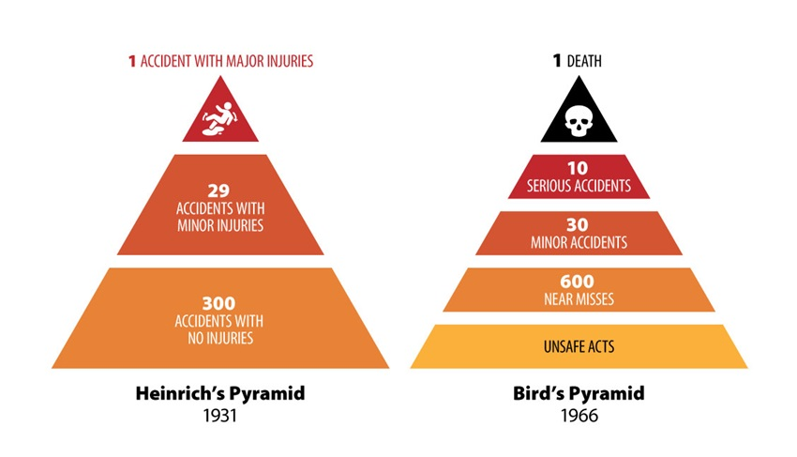
The Safety Pyramid
It is far better to be reporting and learning from near misses, minor incidents and hazards where there is little or no loss, than to be reporting actual serious injuries or even fatalities
Notes:
Trainer: It is briefly worth mentioning Bird and Heinrich’s work (known as the safety pyramid or safety triangle) at the time this was pioneering in analysing the causal factors that led to workplace accidents, highlighting the associated costs (including hidden costs, that are often overlooked) and encouraging managers to think about and invest in prevention of occupational accidents (interrupting an accident sequence).
They were an important contribution to changing practitioners’ view of accidents as part of the “cost of doing business” and primarily resulting from the victim’s lack of care – leading for many years to an over-emphasis on behavioural health & safety. However, many of the findings on accident causality were affected by biases.
Although a useful reference point, accident causality is often more complicated than suggested. As indicated by the following extract from the BP report into the Deepwater Horizon accident:
“The team did not identify any single action or inaction that caused this incident. Rather, a complex and interlinked series of mechanical failures, human judgments, engineering design, operational implementation and team interfaces came together to allow the initiation and escalation of the accident”.

Slide 7
Accident and ill-health costs can be likened to an iceberg: costs that are recoverable (insured) are visible but those that are unrecoverable are hidden below the waterline and are many times greater. Some commentators estimate the hidden cost of accidents can be up to 10 times greater than the insured costs.
Notes:
Trainer:
Self-explanatory slide.
Briefly, run trough some of the headings (not all). Also:
Highlight that not all ‘costs are insured. - Insurance companies will increase premiums the more accidents there are so there is a solid business case for good OHS management. - Workers struggle to claim their legal rights to compensation and personal injury cases/litigation can take years. - What price would you put on your eyesight or one of your hands? (Quickly ask all dominant right-handed people to write their name and address with their other hand in 30 seconds). It is difficult and a very brief example of the fact that any injury may require the individual to retrain their body to accommodate a disability.
Remember, as the saying goes: 2If you think safety is expensive – try an accident”!

Slide 8
Perspectives on OHS (2)
Health and safety is a condition free from risk of injury or threat to our health and well being.
---------- It is an objective to be achieved, not a natural state of affairs.
---------- To achieve a high level of health and safety requires effort and commitment .
---------- There is no such thing as total health and safety , as we can never completely eliminate risks or threats we can only seek to reduce them as far as possible and control those that we cannot eliminate.
Notes:
Trainer:
Self-explanatory slide.
Statements reinforces that all parties have to be vigilant as OHS an ever-changing challenge and we can’t be complacent.
Ask the group if they agree with these statements. (If not, why not?)

Slide 9
What are the four principal motivators to ensure OHS at work?
Moral - our duty towards our neighbours/fellow workers.
Economic - failing to ensure OHS results in costs e.g. due to damages; for medical treatment; coping with disability or fines.
Legal - there are social penalties for failing to ensure our own health and safety or that of others that we may cause to be injured.
For company’s - the responsibility of the company for preventing accidents and ill-health to employees and others. What we do has an effect on others around us - legislation and company rules seek to define the limits of acceptable behaviour.
Notes:
Trainer:
As you arrive at the title of this slide, do not progress the slide any further.
Firstly, ask the group to identify what they believe are the 4 key motivators or ‘drivers’ to ensure OHS at work?
If there is any hesitation of suggestions progress to first point – Moral and then move on…
This slide has animations (the 4 bullet points will transition separately after each click) so ask them the question and then go through 1-4 to summarise the 4 principles if the group does not identify any in their answers.

Slide 10
Discuss the responsibilities of the various employees in terms of company OHS policy
Safety Officer/Manager (OSH & Fire)
Supervisor
Employees
Safety Committee Representatives
Split in to 3 groups allocated by the Trainer. (Each group will be allocated one heading from (a-c) and define the responsibilities of the individual under your heading. Every group should also provide an answer for (d).
(Report back your answers after 10 minutes).
Notes:
Trainer:
Split class into three groups. Ask the 1st group to define the responsibilities of the OHS Manager The next group should do the same for Supervisors; and third group to consider the responsibilities employees have under the OHS policy.
Apart from providing an answer for their individual (a, b, or c) all groups should provide an answer for (d) as well. Compare answers with: ‘MANAGING HEALTH & SAFETY IN THE WORKPLACE’ (Pages 9-11) Department of Inspections for Factories and Establishments (DIFE) Ministry of Labour and Employment.
During report back stress that employees have responsibilities to adhere to policies & procedures & wear PPE etc.
Highlight that the OHS Manager should have a degree of independence and competence to advise both management and workers. The Manager will also liaise with external agencies such Fire Service; H&S Inspectors & Local Authorities etc.
End by identifying that everyone has a role to play in ensuring good OHS standards.
Also remind trainees that the other essential elements of policy & procedures we have already covered on earlier modules when we discussed risk assessment and hazard identification.

Slide 11
Health & Safety Management
Health & Safety literature identifies 5 common factors essential to effective health & safety management:
Policy - a clear statement of the objective to be achieved
Organisational factors - a well structured organisation & allocation of responsibilities to implement the policy
Planning and implementation - to achieve defined standards for safety performance
Measuring performance - against defined standards
Reviewing performance - arrangements for periodic review. Linked to the above four aspects is the auditing process. To help learn from experience monitoring the above
Notes:
Trainers:
Highlight that these factors need to be in place to support effective OHS management system.
If these elements are missing the OHS management approach is likely to be flawed.

Slide 12
An effective health and safety policy should acknowledge the following…
Health & safety can contribute to business performance by protecting resources (both human and physical) reducing costs and illustrating the responsibility of the organisation
Those in authority must develop a structure and culture to support the control of risks and all in the organisation must participate
The need for effective resourcing and planning
The importance of systematic identification and control of risks
The importance of understanding risk control
The requirements of examination and review of performance in order to learn from experience
The principles of good health and safety management and effective quality management are the same.
Notes:
Trainer:
This slide runs through the need for a systematic management approach to dealing with OHS.
As Supervisors & Managers would oversee production quality, productivity and performance, so should they endeavour to ensure that the management of OHS arrangements are treated with the same level of importance.
Poor quality management leads to spoiled products. Poor OHS management leads to sick, injured and, in the worst scenarios, dead workers.
The recognition of the factors highlighted on this slide help underpin the company’s safety policy.

Slide 13
Underpinning elements of OHS policy & practice
The principles of good health and safety management and effective quality management are very similar.
Cooperation between individuals in the organisation is an essential part of OHS management. Individual employees, Supervisors and Managers must interact effectively to ensure OHS is a collaborative effort
Communication is an essential aspect of this effort.
The OHS policy should act as a ‘Statement of Intent’ identifying the company’s commitment to good OHS standards
Notes:
Trainers:
Make the link between the items on this slide and the feedback from the previous slide/exercise. results from each group and present the results on a flip chart or whiteboard if possible. Build on the groups responses by explaining that managers and supervisors are responsible for ensuring that health and safety standards are met. Stress that Supervisors & managers should lead by example in OHS matters . They should be aware of their own limitations in experience and competency and should know when to seek specialist advice.

Slide 14
Supervisors and Managers play a key role in the support of effective OHS arrangements & communications
Management/Supervisors have responsibility:
- for employees in terms of their performance efficiency, industrial relations and OHS.
- to familiarise themselves with the OHS policy in order to fulfil their responsibilities
- to monitor adherence of employees to agreed systems of work,
- to ensuring that OHS arrangements and practise form part of any job specific training and management
- for ensuring the employees keep to agreed systems and do not take dangerous shortcuts or make changes which compromise health and safety.
Notes:
Trainer:
In one of the earlier activities (see slide 7) we have asked the trainees to identify what role and responsibilities Supervisors, Managers, Employees & safety Committee members have in connection with OHS.
This slide summarises some of the ‘softer’ OHS cultural, behavioural and wider responsibilities Supervisors & Managers have in the factory.

Slide 15
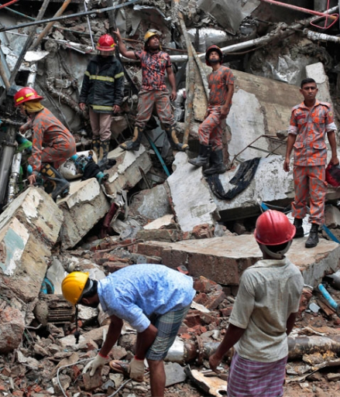
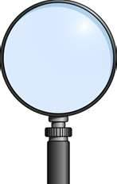
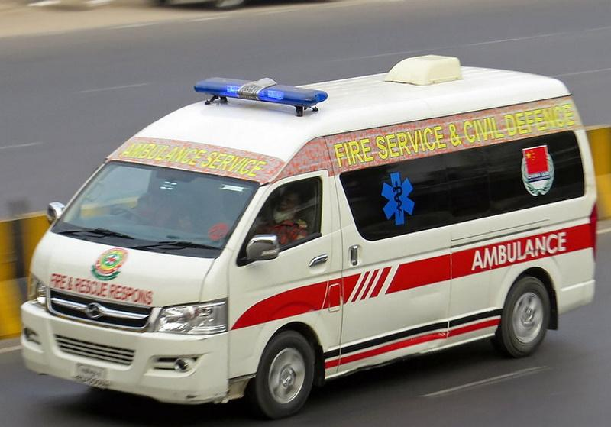
Hazards… …risks… …incidents… …near-misses… …accidents… Accident Causation & Prevention
I
AC
CIDENT
NVESTIGATION
Notes:
Trainer:
Advise the group that the session is now going to explore the important topic of accident investigation. This is an important skills that Supervisors and Managers should develop.
We will cover knowledge, approaches and techniques and theory and practice. Ask them to reflect on any near-misses or accidents they have had in the home, community or workplace and what happened.

Slide 16
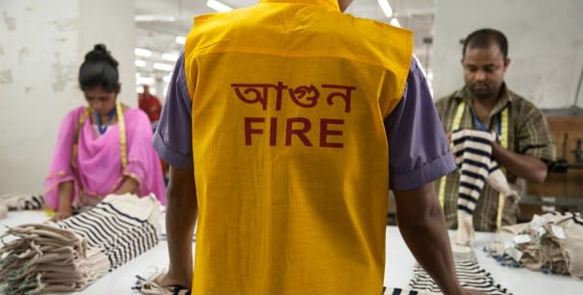
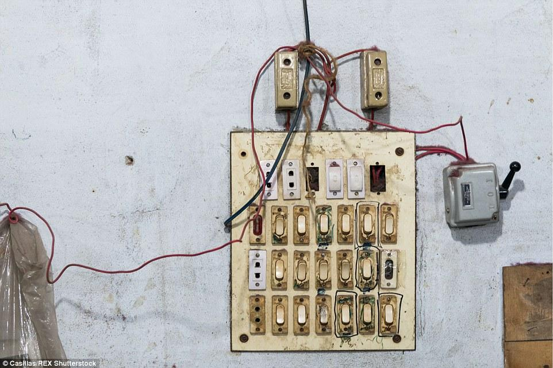
Accident Reporting & Investigation
A brief overview to understand:
accident definition
accident causation
accident costs
accident prevention
Accident reporting/notification
accident investigation
Notes:
Trainer:
Self-explanatory slide.
Very run through key topics to be covered

Slide 17
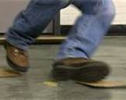
What is an Accident?
An unintended happening or mishap.
Most often, an accident is any unplanned event that results in personal injury or in property damage.
The failure of people, equipment, supplies or surroundings to behave or react as expected causes most accidents.
Notes:
Trainer:
Remind group of definition as we have to have an objective consideration of the complex factors covered by accident causation.
It is inappropriate just to apportion blame to the worker.

Slide 18
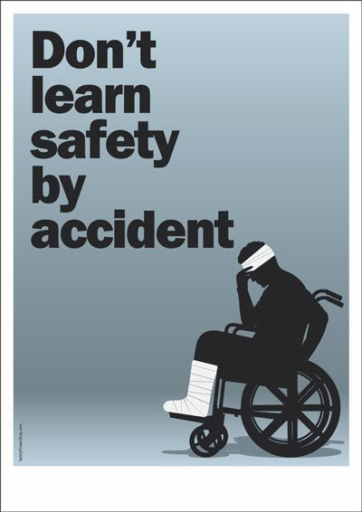
Types of Accidents
Minor Accidents Causing minor injury/illness, requiring little or no treatment or property damage.
Serious Accidents Causing ‘lost time’ cases, visits to the medical centre, accidents where victims are hospitalised, an accident involving a fatality, or damage to equipment and/or property.
Near Miss/Incidents Unplanned event that interrupts the completion of an activity which directly involves the workers but does not result in personal injury, illness or in property damage.
Notes:
Trainer:
We often focus on the accidents and spend less time addressing the incidents or near-misses.
A near-miss is often an accident waiting to happen.
If we are proactive in investigating the near misses and incidents we can often prevent accidents rather than just being reactive after the accident has occurred.

Slide 19
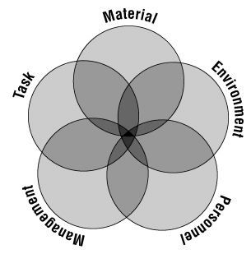
Causes and Contributing Factors of Accidents (1)
Accident Causation Model
Notes:
Trainer:
Explain that consideration of the various aspects or causes of an accident can be broken down in to 5 key headings and that aspects of these may overlap or influence a situation to create or generate an accident

Slide 20
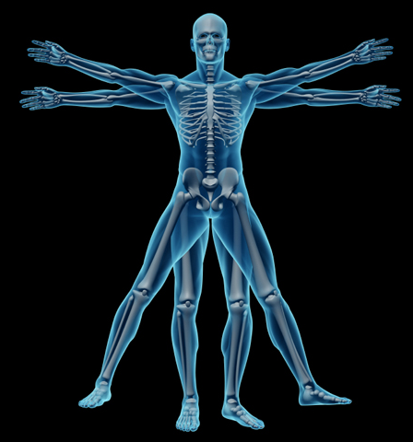
Causes and Contributing Factors of Accidents (2)
Task
Safety work procedures
Ergonomics
Condition changes
Process
Materials
Workers
Appropriate tools/materials
Safety devices
Notes:
Trainer:
Briefly, mentioned the heading/s (Task) on the next few slides but don’t go through every bullet points – just give a flavour of what should be considered.
Remember the slides coloured ‘Blue’ are also for reference after/off-course and it is not necessary to cover everything on the slide.

Slide 21
Causes and Contributing Factors of Accidents (3)
Material
Equipment failure
Machinery design/guarding/maintenance
Hazardous substances (Chemicals, fumes, gases etc.)
Substandard material (poor quality raw materials/products)
Notes:
Trainer:
Again just reference say 2 points. Ask the group if they can suggest any other aspects? For example, a toxic chemical that was used which may have caused respiratory problems.

Slide 22
Causes and Contributing Factors of Accidents (4)
Environment
Internal working environment (Noise, stress, culture etc.)
Weather conditions
Housekeeping (waste, gangways cleanliness)
Temperature
Lighting
Air contaminants (Dust, fumes, poor air quality)
Personal protective equipment
Notes:
Trainer:
Reference the hazards tat may have been identified by the trainees in previous modules (i.e. hazard spotting).
If there is a culture of bullying and harassment in one area of the factory, is this an environmental or human factor?

Slide 23
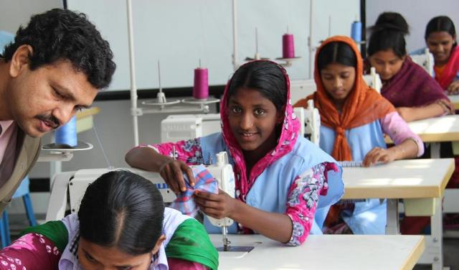
Causes and Contributing Factors of Accidents (5)
Human Factor
Physical capability
Fatigue
Level of experience
Level of training
Health
Stress
Notes:
Trainer:
Ask the group how these aspects can contribute to the causes of accidents - ask trainees to come up with some examples.
You can suggest a few if they are hesitant. E.g. Young inexperienced workers not knowing how to use equipment; a women worker trying to lift heavy loads beyond her capability etc…

Slide 24
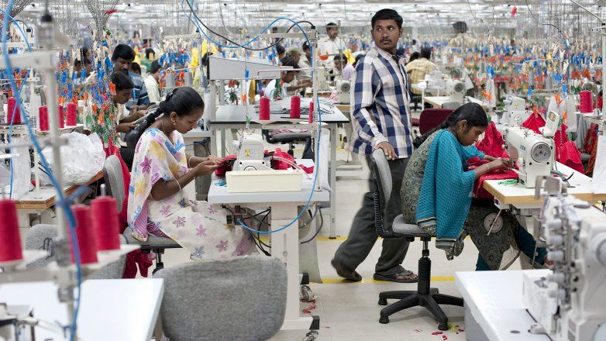
Causes and Contributing Factors of Accidents (6)
Management/Process Failure
Inadequate or lack of OHS policies or procedures
Poor safety inspection regime or absence of safety audits regime
Lack of visible management support for OHS
Lack of knowledge about risks & hazards
Lack of hazard corrective or remedial activity
Absence of enforcement of safety policies
Inadequate supervision
Minimal preventive maintenance
Poor communication or instruction
Notes:
Trainer:
Do not cover every bullet point – just reference a few.
Identify that sometimes the causes of accidents can be as a result of failures in the OHS management system.
Supervisors & Managers may sometimes have to reflect on their own performance, communication and leadership if things go wrong.
It is not about apportioning blame but about eliminating errors to avoid repetition of the cause of the accident – which sometimes may be down to human factors.

Slide 25
What is the Purpose of Accident Investigation?
Determine the sequences of events leading to failure.
Identify the cause of the accident.
Find methods to prevent accident from recurring.
Investigation is not intended to place blame.
Notes:
Trainer:
*Brief Online/Class Discussion Activity. This slide is animated. When the slide first appears, ask the group the question:
What is the Purpose of Accident Investigation? This should generate a brief online/class discussion.
After a few suggestions from trainees click to progress the slide commenting on each tile.
Reiterate it is not about apportioning blame but finding cause to avoid repetition of the accident.

Slide 26
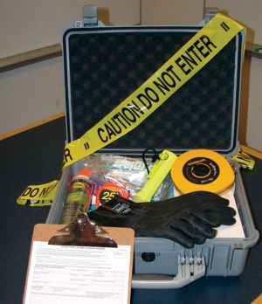
Be Prepared – Accident Investigation Toolkit
Accident Investigation Kit. Preparing a kit of useful forms & tools will help you be more effective once your investigation begins. Keep the kit where it is easily accessible. WHAT SHOULD BE INCLUDED IN AN ACCIDENT INVESTIGATION TOOLKIT?
Pens/Pencils, clip-board, coloured markers & paper
Camera (request permission before taking photographs)
Accident Investigation Forms / Accident Statements
Interview Question Forms
Rubber gloves, googles, ear plugs & mask
Barrier tape / Tape measure / Torch
Sample bags (or containers with labels)
PPE / Hard hat / Safety shoes
Mobile phone or walkie talkie (essential if lone working).
Notes:
Trainer:
*Brief Online/Classroom Discussion Activity.
This slide is animated. When the slide first appears ask the group if they have such a kit in the factory?
(If not, do they think it would be a good idea to have one - if so, why?) Ask them what they would include in such a kit if they don’t have one?
After their input ‘click to progress slide to reveal suggested equipment/resources that could be included.

Slide 27
Serious Accident Initial Response (1)
Get
Get the first aid kit and assist victim following accepted standards of care, if trained to do so. Otherwise, wait for emergency medical services to arrive.
Do not move
Do not move the victim unless it is absolutely necessary (e.g. the building is on fire, there are hazardous fumes in the area, etc.)
Turn off
Turn off any equipment or power switches that need to be turned off.
Do not move
Do not move anything in the area.
Notes:
Trainer:
Briefly ,run through suggested response in cases of serious accident.

Slide 28
Initial Response (Serious Accident) (2)
Make a note of the people involved that will need to be interviewed later.
Use barricade tape or other means to block-off the area.
Notify the department fire marshal, medical/welfare centre, OHS Manager and request contact is made with Fire or Ambulance services as appropriate.
Other workers should be directed to return to work to reduce interference with rescue workers and to prevent secondary accidents.
Once victim/s has been safely removed, take any photographs or make drawings identifying locations of injured person etc.
Notes:
Trainer:
Briefly, run through second bullet point, do not cover every one.
Highlight that many of these slides are for reference off/after the course.

Slide 29
Initial Response (Minor Accident) (3)
Get
Get the first aid kit and assist the victim following accepted standards of care, if required.
Turn off
Turn off any equipment or power switches that need to be turned off. Do not move anything in the area.
Make
Make a note of the people involved that you will want to interview later.
Notify
Notify your departmental safety representative and management.
Get
Get your accident investigation kit and begin your investigation.
Make
Make sure you take samples or any evidence as appropriate.
Notes:
Trainer:
Again, only briefly, run through the last block – gathering evidence.

Slide 30
Asking the right questions: Remember the 5W’s
WHO?
WHEN?
Who was working with him/her?
Who else witnessed the accident?
Who else was involved in the accident?
Who is the employee's immediate supervisor?
Who rendered first aid or medical treatment?
When did the accident occur?
When did the employee start work?
When did the worker begin employment?
When was job-specific training received?
When did the supervisor last check the job/area?
Notes:
Trainers:
Do not cover every bullet point – pick out a few items from each slide.
Remember to remind trainees that the ‘Blue’ slides are for reference off/after the course.

Slide 31
WHAT Happened?
WHAT?
WHAT?
What was the injured employee’s explanation?
What were they doing at the time of the accident?
What was the position at the time of the accident?
What is the exact nature of the injury?
What operation was being performed?
What materials were being used?
What safe-work procedures were provided?
What PPE equipment was used?
What PPE was required?
What elements could have contributed?
What guards were available but not used?
What environmental conditions contributed?
What related safety procedures need revision?
What hours was the worker working?
What ergonomic factors were involved?
Notes:
Trainers:
Do not cover every bullet point – pick out a few items from each slide.
Remember to remind trainees that the ‘Blue’ slides are for reference off/after the course.

Slide 32
Keep asking WHY? Ask why again after every answer!
WHY?
WHERE?
Why did the accident occur?
Why did the worker do what he/she did?
Why did co-workers do what they did?
Why did conditions come together at that moment?
Why was the worker in the specific position?
Why were the specific tool/equipment selected?
Where did the accident occur?
Where was the worker positioned?
Where were eyewitnesses positioned?
Where was the supervisor at the time?
Where was first aid initially given?
Where/on what part of the body did the victim sustain injuries?
Notes:
Trainers:
Do not cover every bullet point – pick out a few items from each slide.
Remember to remind trainees that the ‘Blue’ slides are for reference off/after the course.

Slide 33
HOW?
How did the accident occur?
Remember! This is your ‘root cause analysis’! *
How did communication breakdown (If appropriate)
How did the worker get injured (specifically)?
How could the injury have been avoided?
How could witnesses have prevented it?
How could witnesses have better helped?
HOW COULD THE ACCIDENT HAVE BEEN PREVENTED?
*(See next 2 slide for explanation of ‘route cause analysis’ approach…
Notes:
Trainers:
Do not cover every bullet point – pick out a few items – encourage trainees to review the information/evidence from their investigation and be objective in their analysis of the causes of the accident.
Their report should focus on solutions and proactive remedial actions to eliminate or control the causes of the accident to avoid repetition of such an event again in the future.
The Safety committee should play a role in analysing the accident and the remedial measures.
Management should also focus on any potential policy, procedural or risk assessment changes and how they will communicate the findings and preventative measures to the rest of the workforce.

Slide 34
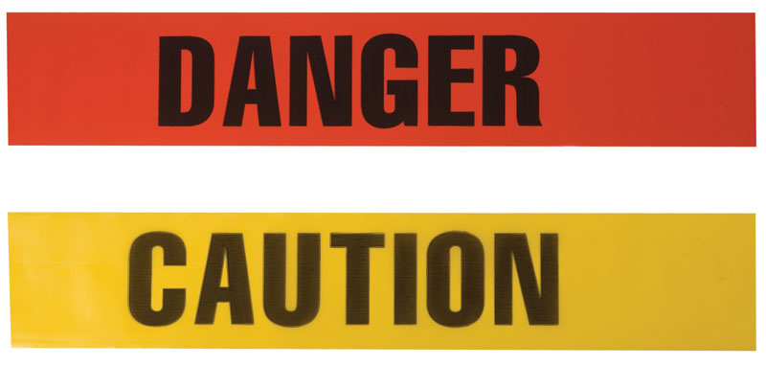
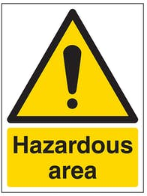
Remember! Facts and Physical Evidence
Scene: Take photos/sketch the accident and document Conditions
Sequence of Events: (Work your way backwards to fill in events leading up to the accident based on witness statements and interviews. This is known as ‘tracing the tree of cause’).
People/witnesses: (Don’t jump to conclusions or be biased. Avoid apportioning blame use open & closed questions techniques).
Supervisor: Should complete Accident Statement. He/she may also be able to provide information regarding earlier behaviour, activities of person(s) involved in the accident.
Parts: Material, machine, equipment, or structure. Identify "parts" to be further investigated. For complex systems, technical experts, manufacturer representatives, or inspectors may need to be involved in the review.
Paperwork: Policies, practices, protocols, training, and assessments etc.
Notes:
Trainer:
Encourage the trainees to think of accident investigation as capturing a story or a true and accurate picture of what led up to the accident.
As narrator, they have to tell a (true) story; there are actors or characters (the workers) in the story, the scene is set in the workplace, there is a beginning, middle and end.
There are lessons to be learnt from the story and if the story is about an accident rather than a near-miss, it might not have a happy ending!

Slide 35
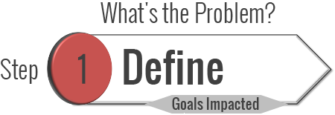
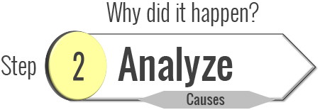
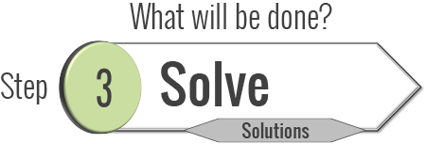
‘Route Cause Analysis’
Root cause analysis is an approach for identifying the underlying causes of an incident so that the most effective solutions can be identified and implemented.
Within organisations, problem-solving, incident investigation and root cause analysis are all fundamentally connected by three basic questions:
People often disagree over how to define the problem. Secure alignment when the problem is defined by the ‘impact on/to the (OHS) goals’.
Break the problem down into a visual map. Using a Cause Map provides a thorough explanation revealing all of the causes required to produce the problem.
Prevent/mitigate any negative impact to the goals by selecting the best solutions. Effective solutions should change behaviours and how people work.
Notes:
Trainer:
Root cause analysis is about digging beneath the surface of a problem. However, instead of looking for a single “root cause”, shift your problem-solving paradigm to reveal a system of causes.
When using the Cause Mapping method, the word root in root cause analysis refers to causes that are beneath the surface.
It also relates to the “Domino Effect”. Visualise a row of domino’s falling – as it falls each domino has an effect on the one in front of it. The ‘accident’ is the last domino we see falling.
However, if we trace the causes back to the previous domino and beyond we will get to the numerous causes of the accident.
(Thinkreliability).

Slide 36
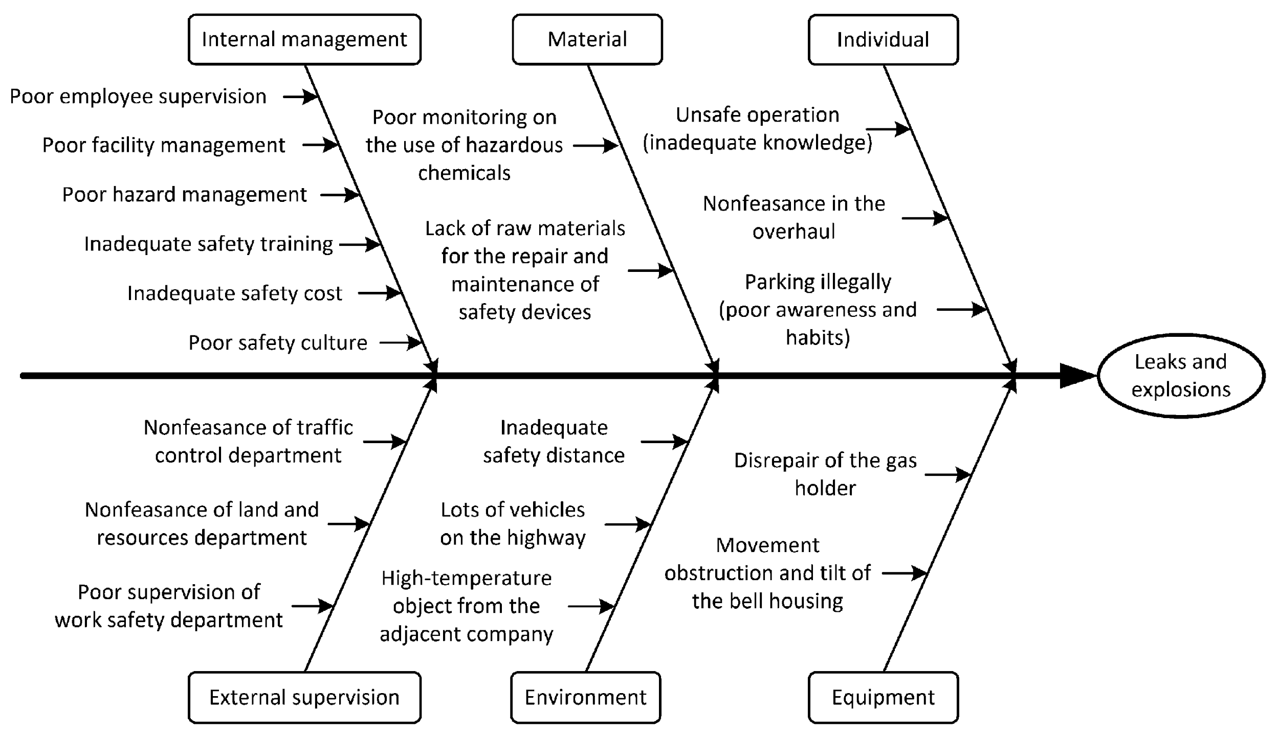
Brainstorm all the possible causes of the problem. Ask “Why does this happen?” Use the 5 Why’s. Again asks “Why does this happen?” about each cause…
Root cause analysis is a structured team process that assists in identifying underlying factors or causes of an accident or near-miss. Understanding the contributing factors or causes of a system failure can help develop actions that sustain the correction.
A cause and effect diagram, often called a “fishbone” diagram, can help in brainstorming to identify possible causes of a problem and in sorting ideas into useful categories.
Notes:
Trainer:
This slide illustrates the root cause analysis of a ‘leaks & explosion’ accident (see the ‘head of the fish’).
Explanation for how to use this technique is contained in the Blue highlighted boxes at the side of the diagram.
‘Nonfeasance’ means ‘failure to perform an act required by law.

Slide 37
Accident Analysis – can include review of…
Suggested categories include:
People (Witnesses, co-workers, Supervisors, external agencies as appropriate)
Policies
Procedures (including Safe Operating Procedures; risk assessments etc.)
Processes
Machinery
Materials
Environment (facilities, weather, noise, lighting, etc.)
Technology
Communication
Supervisory & Management arrangements
Notes:
Trainer:
Self-explanatory slide

Slide 38
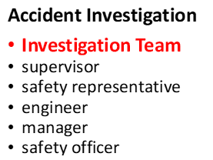
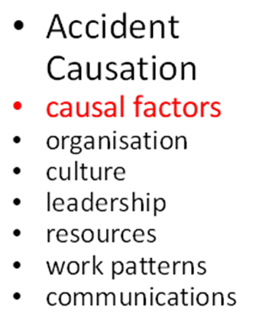
Accident Investigation
Reasons
Identify root causes
Identify faults
Identify corrective/preventative actions
Prevent reoccurrence
Notes:
Trainer:
By way of summary in connection with the previous slides, highlight that the investigation objectives of these activities is to: - establish chain of events; - identify root causes; - identify faults; - identify corrective/preventative action.
The final part of the process should be to prepare an ‘Accident Investigation Report’. This should include: details about:
identify team of the investigating officer/or team
summarise consequential events (as a result of the accident)
identify root causes
describe other weaknesses
identify corrective/preventative action 9Recommendation)
allocate responsibility & timescale (and where appropriate financial implications or budget measures).

Slide 39
Accident Investigation: Putting theory into practice.
In groups, applying what you have just learnt about accident investigation, choose an accident you identified earlier in the course and develop a root cause analysis diagram to explore the sequence of contributing factors that led to the accident.
Be prepared to report back your findings to the whole class.
Use a flip chart if possible
You have 15 minutes to complete this activity. a spokesperson to report back your findings on behalf of your group.
Notes:
Trainer: Identify 3-4 accidents that have been discussed during the course or ask the Safety Manager to provide information about accidents that have taken place in the factory.
Ask the trainees to apply what they have learned on this module and ask them to develop a fishbone diagram or mind-map illustrating the 5W’s; causes of the accidents and the sequence of events leading up to the accident.

Slide 40
QUIZ TIME (Testing Your Knowledge About Accident Investigation)
Individually (or in a group) click on the link below and take a short assessment about accident investigation.
There are 10 questions
Good Luck!
https://forms.office.com/Pages/ResponsePage.aspx?id=DQSIkWdsW0yxEjajBLZtrQAAAAAAAAAAAAYAAPOPuh9UOFlWUUU5TVJYUk5BVFBWUVhPVE9UMEJMVC4u
Notes:
Trainer:
Quiz Questions (Correct Answers):
Q1: D Q2: (True) Q3: (True)
Q4: (True)
Q5: D
Q6: (True)
Q7: (False) Q8: (True) Q9: (True) Q10: D

